Slide 1
Semi-supervised Learning for Data Augmentation
Bachelor’s project (supervised by Dr Sean Holden)
Nikola Mrkšić Trinity College, University of Cambridge nm480@cam.ac.uk

Slide 2
Data Augmentation
Input: training set T_{r} and unlabelled set U
Output: Augmented training set T_{r}⁺
Three-fold problem:
Choose the benchmark classifier, whose performance the procedure is trying to improve
Identify application areas (data sets to augment)
Create the augmented data set for the classifier by finding hidden elements of each class in U
Support Vector Machine as benchmark classifier
Comparability between different application areas
Notes:
We need a wrapper general method to create an augmented data set, and a separate method for determining how applicable the constructed augmented data sets are (i.e. by How much they improve classification accuracy!)
In this work, we fixed on an SVM as the benchmark classifier. The final part of this talk will discuss a better way to do this based on my current research project.

Slide 3
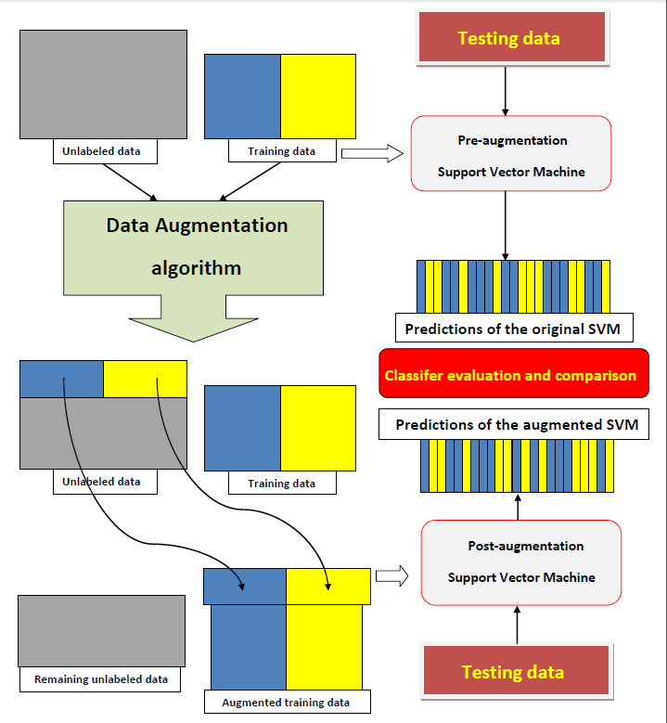
Data Augmentation via Entity Set Expansion
Goal 1
(Entity Set Expansion)
A ‘wrapper’ data augmentation procedure capable of producing augmented data sets for arbitrary application areas
Entity Set Expansion
Goal 2
(Data Augmentation)
A framework for assessing the potential for data augmentation in the specific application area prior to trying data augmentation

Slide 4
Entity Set Expansion
Given positives’ set P and an unlabelled set U, create an expanded set P⁺ by extracting hidden positives from U
Ranking method: Bayesian Sets
Sort elements of U by their likelihood of belonging to P
Classification: Partially Supervised (PU) Learning
Spy Expectation Maximisation (Spy-EM)
Rocchio-SVM (Roc-SVM)
Notes:
Could be treated as an independent problem, but we are interested not just in the purity of the extracted set, but mostly on the impact on data augmentation...

Slide 5
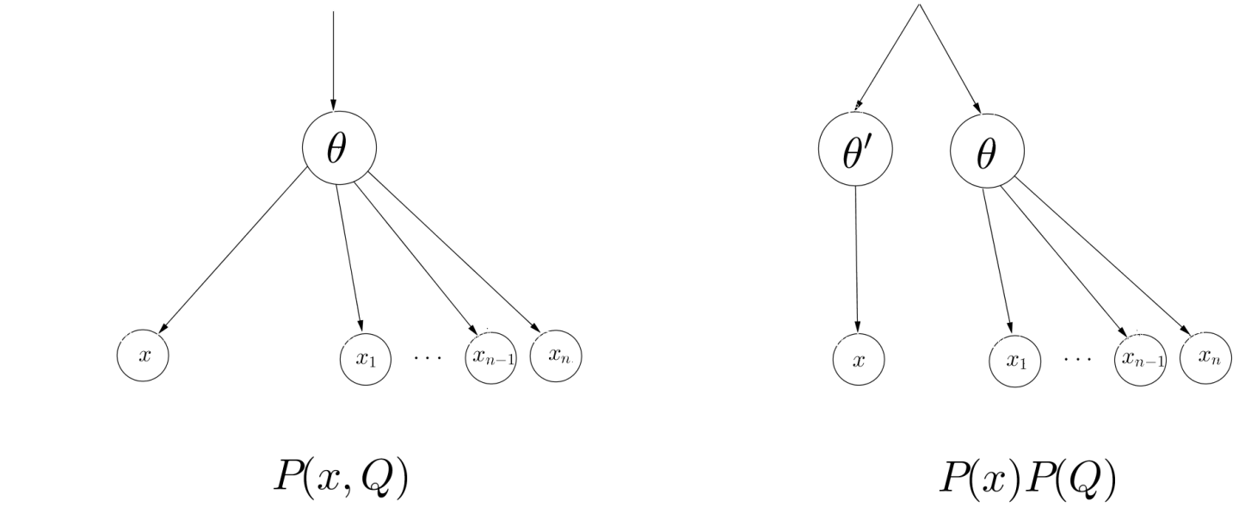
Bayesian Sets: a ranking method
Assume all examples are drawn i.i.d. from the same model P(x|Ɵ), and that instances from the same class Q are always generated by the same set of parameters Ɵ_{Q}
Given a ‘query’ consisting of an ‘entity set’ Q, we want to rank all the examples by their probability of belonging to the class Q

Slide 6
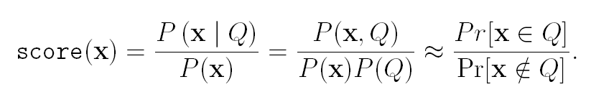
Bayesian Sets: likelihoods vs. probabilities
With sparse binary data, model the marginal probability with the Bernoulli distribution, and the prior with the Beta distribution (its conjugate prior) to allow exact inference
Not only do we calculate the score exactly, but we can do it very efficiently, with a single sparse matrix multiplication
The scores represent the likelihoods that each instance belongs to the input ‘concept class’. These scores can be used to order the elements, but not to find a set expansion cut-off point directly; there is no simple way to convert the scores into probabilities

Slide 7
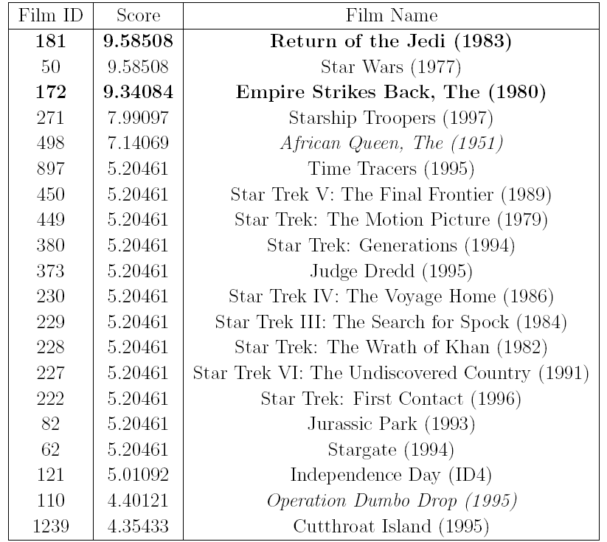
Bayesian Sets: example (MovieLens)
IR inspired algorithm
2 Star Wars and 1 Indiana Jones film as input
Other IR tricks? Pseudo (blind) relevance feedback to allow automatic query expansion?

Slide 8
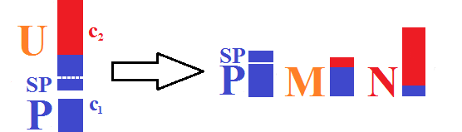
Positive Unlabelled (PU) Learning
PAC framework: precision and recall of the classifier approach 100% even without any labelled negative examples
Negative Data can harm classification (Li et al, 2010)
Too general/weak for the purposes of Data Augmentation?
Spy-EM: use a set of spy positives SP inserted into the mixed set U to extract a set of reliable negatives RN from U
Notes:
Here, we choose to disregard knowledge of the negative classes, that is the fact that we have instances of all classes available.
Reason 1: Entity Expansion schemes as general as possible.
Reason 2: We can utilise this knowledge during the final data augmentation steps.
No negatives. CLT, PAC framework, shown that Precision and Recall on P grow to 1 as the size of the positive and unlabelled sets increases. No negative examples need to be introduced at any point. Ensures most general approach.
Sampling bias -> use of negative data can harm classification. (Li et al. , 2010)
Can delay the use of knowledge of negative sets to the data augmentation step. The purification step removes any elements which belong to more than one augmented class.

Slide 9
Spy Expectation Maximisation
Iteratively build a sequence of classifiers that split the data in mixed set U between P and reliable negatives’ set RN
Naive Bayes classifiers used to implement EM
The iteration is repeated until all the posteriors for U converge
Posteriors assigned to spy positives resemble the posteriors assigned to the hidden positives
Finding the cut-off threshold is non-trivial in the noisy case
Algorithm primarily designed for (binary) text classification
No support for continuous features
Notes:
In each iteration, P and RN grow until there are no elements left in U. Posteriors for N are allowed to change, posteriors for P are not.

Slide 10
Rocchio SVM: continuous features
Naive Bayes classifiers are replaced by Support Vector Machines
SVMs iteratively trained using P and the reliable negatives set RN
Each subsequent SVM tries to extract more negatives from U
The Reliable Negatives set extracted using Rocchio clustering
k-means clustering to find centroid vectors of all negative classes in U
K-means Rocchio clustering substantially raises the purity of the RN set constructed and reduces the noise introduced during the subsequent iterative training process augmenting set P
Improvements in accuracy come at the price of time complexity
Naive Bayes is linear, but SVM training goes up to cubic time
Notes:
This was necessary as this procedure was much more susceptible to noise

Slide 11
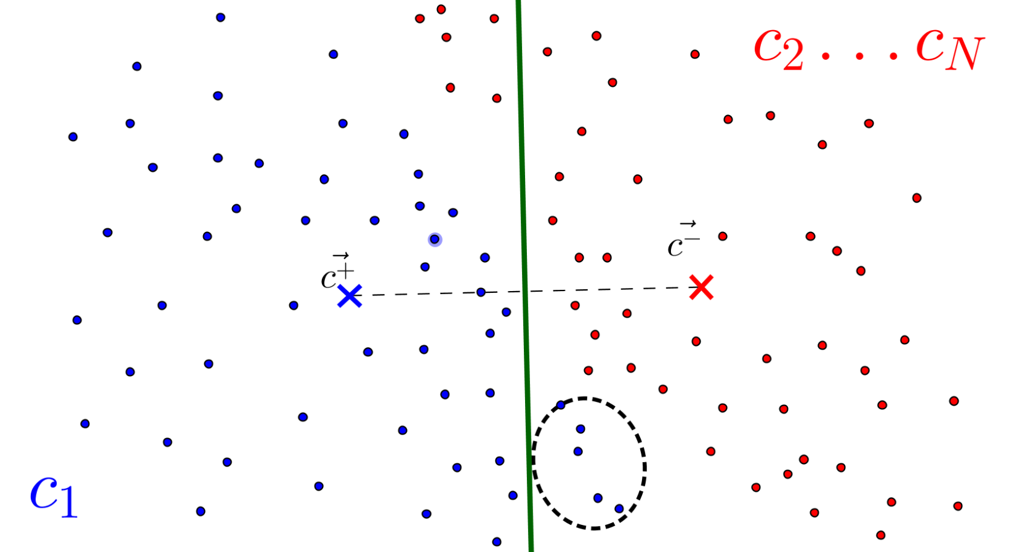
Rocchio SVM: increase the purity of RN
There may be more than one negative class in the unlabelled set U
Notes:
Explain that this leaves the hidden positives in RN, thus completely ruining the RN extraction process.

Slide 12
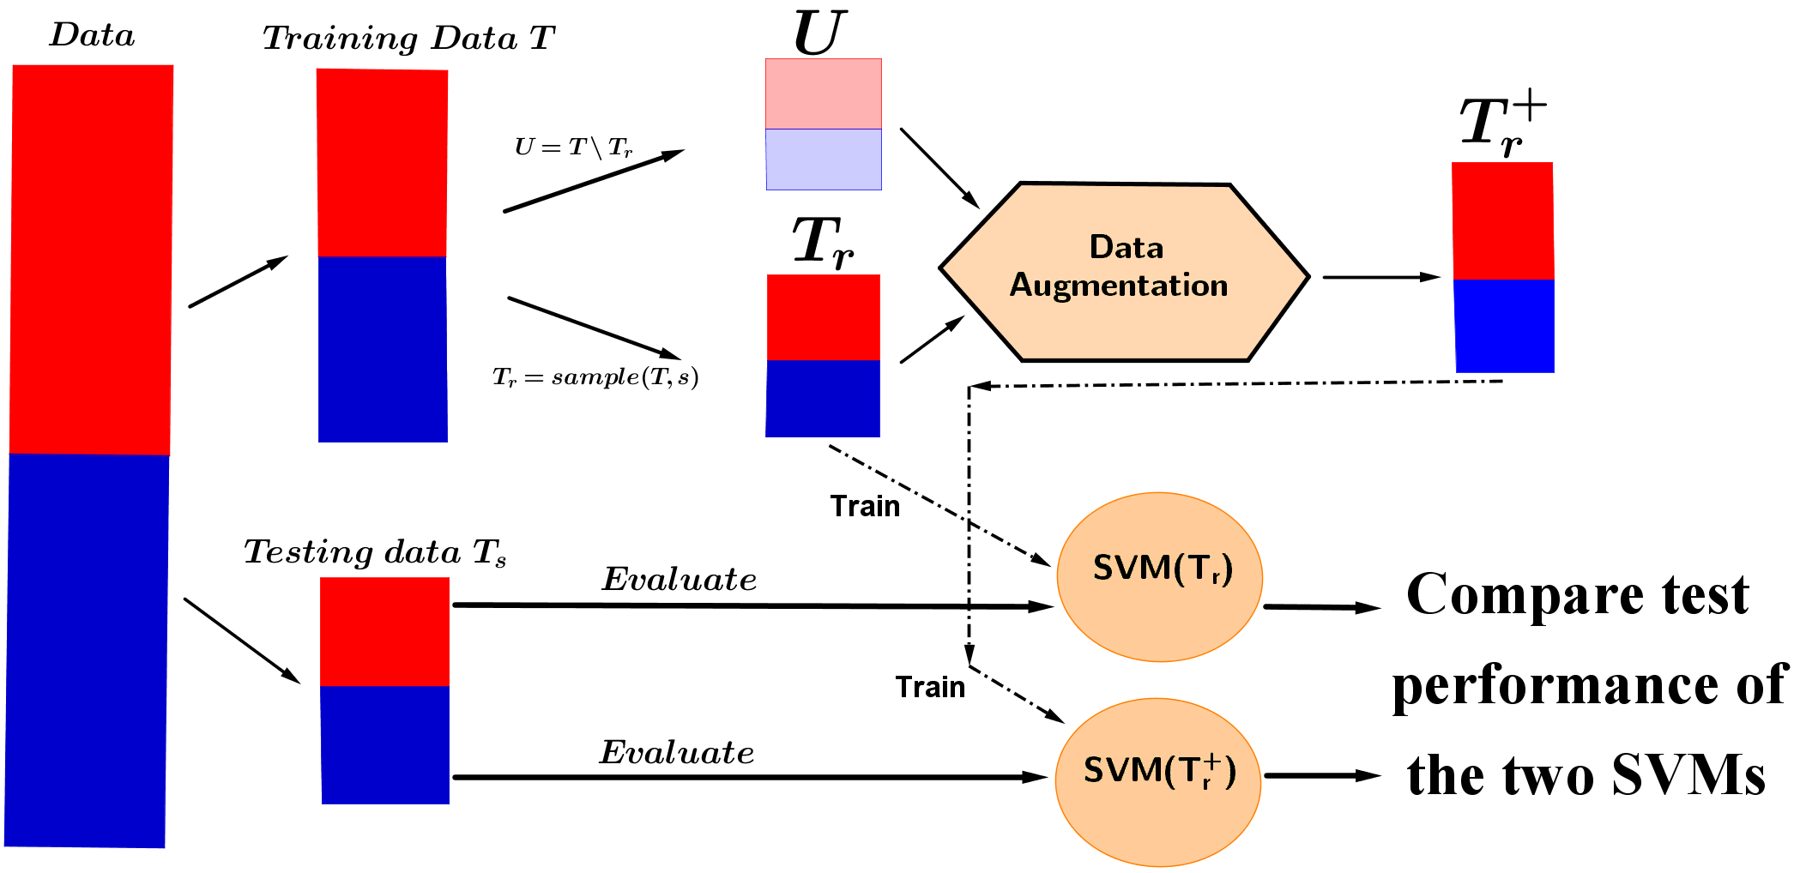
Data augmentation: Evaluation Framework
Different sampling ratios = different amounts of unlabelled data available
Notes:
Given an arbitrary data set, how do we deem if we can use unlabelled data to reduce classification error? Different rates of learning etc. – how much data do we need?
The creation of this fake Unlabelled Set allows us to later compare and determine whether the actual Unlabelled set has the same effect as the mock one.
Say what the baseline is, say what the ceiling performance is. Baseline is training just using the sampled T_r, the ceiling is when trained using all of the training data T.

Slide 13
Data augmentation: application areas
Text classification (Reuters21578, MovieLens)
Binary classification; 18933 binary features
Same T_{r} and T_{s} class distributions
Bio-molecular activity prediction (KDD Cup 2001)
Binary classification; 139351 features
Few positives in T_{r} (42/1909), sampling bias between T_{r} and T_{s}
Supervised theorem proving (Bridge et. al, 2013)
Multi-class (five different ATP heuristics)
51 real-valued features representing properties of formulae
Body of actual unlabelled data from the original project

Slide 14
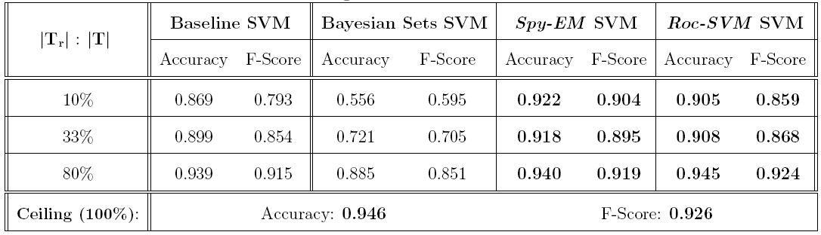
Text classification (Reuters 21578)
18933 binary features, binary classification
Bayesian Sets use the same cut-off as Spy-EM
PU Learning achieves consistent improvements in classification performance

Slide 15
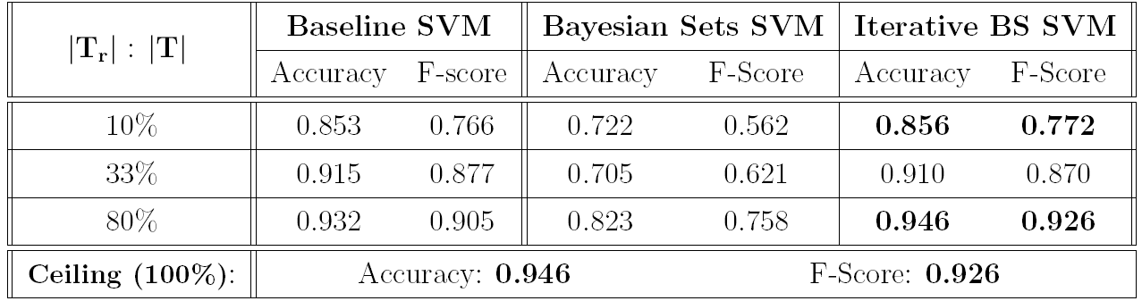
Iterative (bootstrapped) Bayesian Sets
Blind relevance feedback repeatedly expands the input query with top results obtained using the previous query

Slide 16
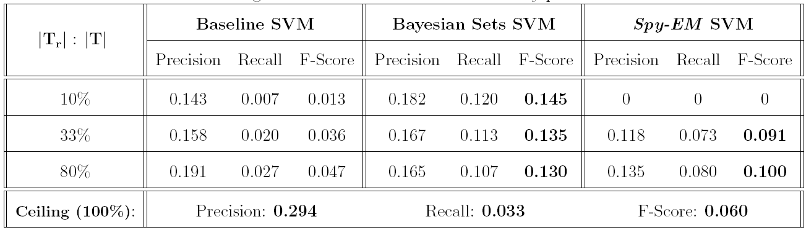
Bio-molecular activity prediction
KDD Cup 2001; Task 1: ‘Binding to Thrombin’
139351 features, sampling bias (2.2% vs. 23.6%)
Both methods boost performance above the ‘ceiling’ by raising recall figures (almost) by an order of magnitude
Bayesian Sets outperform Spy-EM (fails for small training sets)
Notes:
Say that accuracy is no longer most important... Due to low number of positives.
Pathetic baseline, not enough training data,
Wrongly labelled examples introduced into a small Tr set can completely ruin SVM performance (SpyEM 10% case)

Slide 17
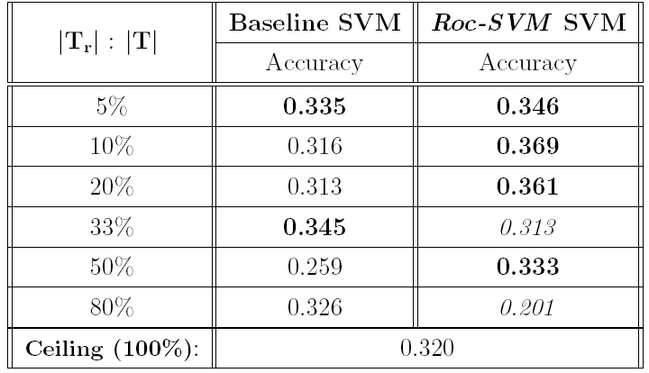
Supervised Theorem Proving
Bridge, Holden and Paulson, Journal of AR, 2014
5 classes, 51 real-valued features represent statements
Acute lack of training data
Notes:
Error bars?

Slide 18
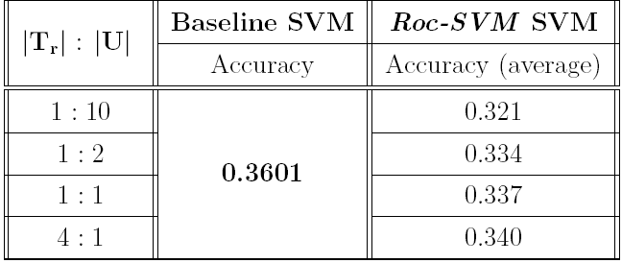
Supervised Theorem Proving
Given a body of unlabelled data U’ that no heuristic managed to prove (different nature to training data):
Hypothesis: given the absence of even minuscule improvements formerly observed with (fake) unlabelled data, we conclude that U’ can not be used to raise accuracy

Slide 19
Summary: results and conclusions
A ‘wrapper’ method for improving classification performance by creating augmented data sets in arbitrary application areas
An evaluation framework deciding (a priori) whether the method will be successful at raising classifier performance
Successfully raised classification performance in text classification and drug-design related application areas
PU Learning Algorithms are capable of raising classification performance even though they ignore negative labels
Bayesian Sets have shown limited potential due to the absence of a clear cut-off criterion for the rankings produced
The unlabelled data set available from the supervised theorem proving project is of no use for improving classification

Slide 20
Idea 1: Automated Statistician?
Kernel Structure Discovery for GP classification
The kernel structure discovery procedure for regression (Duvenaud, Lloyd et al, 2013) evaluates kernels using their marginal likelihood
Bayesian Information Criterion (BIC)
Approximates marginal likelihood for probit likelihood functions, to express how well that GP kernel captures the underlying structure of the data
Changes in the BIC value of the final kernel returned by the structure discovery procedure could be used to guide the augmentation, as the BIC reflects the consistency of the new, augmented data set
Couple structure discovery and data augmentation
Extract as many examples from U, while introducing as little noise as possible into P (maintain consistency / marginal likelihood)
Issue: the BIC value scales with the size of the training set used
Notes:
First thing: we get a tailored classifier.
Second thing: use BIC criteria for guidance in data augmentation (how many examples we can introduce before data loses consistency)

Slide 21
Synthetic data: 4 dimensions; different SNR ratios

Slide 22
Increasing noise levels leads to choice of simpler covariance functions

Slide 23
Idea 2: Spy (Iterative) Bayesian Sets
Bayesian Sets are (by far) the fastest method implemented
Separate experiments on independent entity expansion tasks show that they have comparable performance to PU Learning
Use Bayesian Sets as the driving force for a PU algorithm?
More sophisticated than Naive Bayes
More efficient than (the training of) Support Vector Machines
Lack of a clear cut-off criterion in the rankings
The use of spy positives was instrumental for the performance of Spy-EM: identifying the RNs and thus separating the data
A similar approach could be used to tackle Bayesian Sets
Observe the spy positives in the rankings to draw the final line

